Slide 1
ALGORITHM
Introduction to programming – Nhập môn lập trình
Trương Toàn Thịnh

Slide 2
CONTENTS
Conception
Description
Analysis
Example

Slide 3
CONCEPTION
Before modern computer, we solve the practical problems ourselves
Problems having big data, high precision with real time → we cannot solve ourselves
Appearance of electronic computer is a necessary thing with ‘As quick as a flash’ by nature
We need to model practice problems into data structures
We instruct computer how to solve the practical problems
Method of dealing with practical problems is called algorithm

Slide 4
CONCEPTION
Some algorithm standards
  Limitation: finish execution after amount of processing–steps
  Determination: Each processing–step must be apparent
  Existence of input data: Algorithm needs a valid input data
  Existence of output data: give a expected result corresponding to valid input data
  Efficiency: Each processing–step must have limited – deterministic time
  Popularity: Apply for a family of problems

Slide 5
CONCEPTION
Describe algorithm
  Natural language
  Flow – chart
  Pseudo – code
  High – level programming language
Implement algorithm
  Turn algorithms into executable form
  Using programming languages to realize the algorithm’s processing–steps
  This transformation is called algorithm implementation

Slide 6
CONTENTS
Conception
Description
Analysis
Example

Slide 7
DESCRIPTION
Example: find the largest number in array including n elements: a₀, a₁, a₂, …, a_{n}.
Using natural language to describe our solution (algorithm)
  Advantage: Easy to express
  Drawback: Polysemy in natural language easily causes misunderstanding
  Suitable for simple short algorithm
  Need to use more symbol and various methods to efficiently enhance algorithm description

Slide 8
DESCRIPTION
Using natural language to describe our solution (algorithm)
  Step 1: Let lc ← the first number in array
  Step 2: If there is no number in array, then go to step 4
  Step 3: If the next number is greater than lc, then we assign this number to lc. Return to Step 2
  Step 4: lc is the largest number in array

Slide 9
DESCRIPTION
Example: consider array 4 2 8 9
  Step 1: lc ← 4
  Step 2: Still, there are 3 numbers
  Step 3: See if 2 > lc, so don’t assign 2 to lc. Return to step 2
  Step 2: Still, there are 2 numbers
  Step 3: See if 8 > lc, so assign lc ← 8. Return to step 2
  Step 2: Still there is one number
  Step 3: See if 9 > lc, so assign lc ← 9. Return to step 2
  Step 2: There is no number in array, then go to step 4
  Step 4: lc = 9 is the largest number in array

Slide 10
DESCRIPTION
Example: find the largest number in array including n elements: a₀, a₁, a₂, …, a_{n}.
Using programming language to describe algorithm
  Advantage: run immediately
  Drawback: need to understand programming language in use
  Maybe make a ‘workaround’ to express some simple idea in algorithm
  Maybe cause algorithm description lose its simplicity and fail to express the nature

Slide 11
DESCRIPTION
Using programming language to describe algorithm
int FindTheLargestNumber(int a[], int n){
int i, max;
max = a[0];
for(i = 0; i < n; i++){
if(max < a[i])
max = a[i];
}
return max;
}

Slide 12
DESCRIPTION
Using flow–chart to describe algorithm
  Advantage: easy to understand
  Drawback: only suitable for simple short algorithms
a₀, …, a_{n-1}
max = a₀
i = 1
S
i<n
Đ
max<a_{i}
S
i = i + 1
Đ
max = a_{i}
max

Slide 13
DESCRIPTION
Using pseudo–code to describe algorithm
  Using syntax of some popular programming languages
  Maybe using more mathematical symbols
max ← a₀
i ← 1
while(i < n) do
if(max < a_{i}) then
max ← a_{i};
end if
end while
write max;

Slide 14
CONTENTS
Conception
Description
Analysis
Example

Slide 15
ANALYSIS
Check if algorithms do what they need to do (expected things we want)
Check if our algorithm is better or worse than others
Algorithm has two properties
  Correctness
  Complexity
    Time complexity
    Space complexity

Slide 16
ANALYSIS
Correctness
  Algorithm must give valid results corresponding to valid input values
  Proving our algorithm to be correct with ALL input values is not simple
  Maybe using induction in some cases
Time complexity
  With the same working condition, the first algorithm giving valid results is better than the others
  With multi-purpose computers, it is difficult to force CPU to run at full capacity to compare among algorithms
Xét dãy số fibonacci
F₀ = 0, F₁ = 1
F_{n} = F_{n-1} + F_{n-2} nếu n ≥ 2
Ví dụ: n = 5 → 0, 1, 1, 2, 3, f₅ = 5

Slide 17
ANALYSIS
Algorithm computing F_{n} of fibonacci
F₀ = 0, F₁ = 1
F_{n} = F_{n-1} + F_{n-2} nếu n ≥ 2
Algorithm 1:
Input: n
If n ≤ 1 then result = n
Else
a = 0, b = 1
for each k = 2 → n do
c = a + b
a = b
b = c
end for
result = c
End if
Write result

Slide 18
ANALYSIS
Algorithm computing F_{n} of fibonacci
F₀ = 0, F₁ = 1
F_{n} = F_{n-1} + F_{n-2} nếu n ≥ 2
Algorithm 2:
Input: n
If n ≤ 1 then result = n
Else
A = Tính Fibo(n – 1)
B = Tính Fibo(n – 2)
result = A + B
End if
Write result

Slide 19
ANALYSIS
Time comparison between two algorithms
Comparision
N | Algorithm 1 | Algorithm 2
40 | 41 ns | 1048 μs
60 | 61 ns | 1 s
80 | 81 ns | 18 m
100 | 101 ns | 13 d
120 | 121 ns | 36 y
160 | 161 ns | 3.8 × 10⁷ y
200 | 201 ns | 4 × 10¹³ y

Slide 20
ANALYSIS
Space complexity
  Consider the consumption of system resources (RAM, CPU…)
  Consider data structures to process and represent data
Example: two swap algorithms
  The second algorithm is better the other because it consumes less memory
temp ← a;
a ← b
b ← temp
a ← a + b;
b ← a – b;
a ← a – b;

Slide 21
CONTENTS
Conception
Description
Analysis
Example

Slide 22
EXAMPLE
Consider theoretic complexity
  Count the times of basic operations
  Don’t care about physical time one basic operation consumes
  Basic operation is a computation, assignment or transmission of data values
  The times of basic operations depend on amount of input data
  It is said that theoretic complexity is a function of n, where n represents amount of input data (f(n))

Slide 23
EXAMPLE
Consider theoretic complexity of linear search algorithm
  Consider n integers, find if another integer k appears in number array or not
  Worst case: must compare all n elements → theoretic complexity is O(n)
i ← 0
while(i < n & (k ≠ a_{i})) do
i++
end while
if(i < n) then
result ← i
else
result ← -1
end if

Slide 24
EXAMPLE
Consider theoretic complexity of binary search algorithm
  Choose n integers ascending, find if integer k appears in number array or not
left ← 0, right ← n – 1
while(left ≤ right) do
mid ← (left + right)/2
if(k = a[mid]) then
result ← mid
STOP
else
if(k < a_{mid}) right ← mid – 1
else left ← mid + 1
end if
end while
result = -1

Slide 25
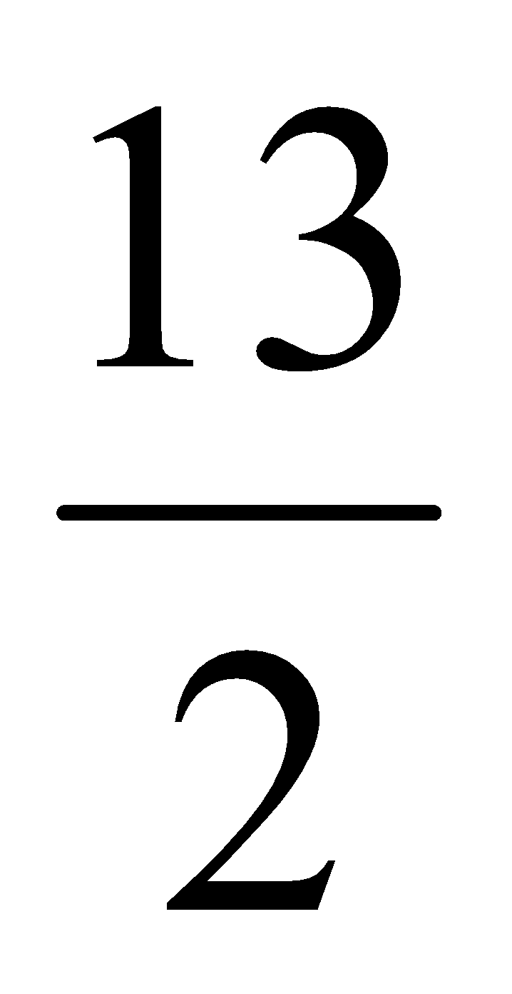
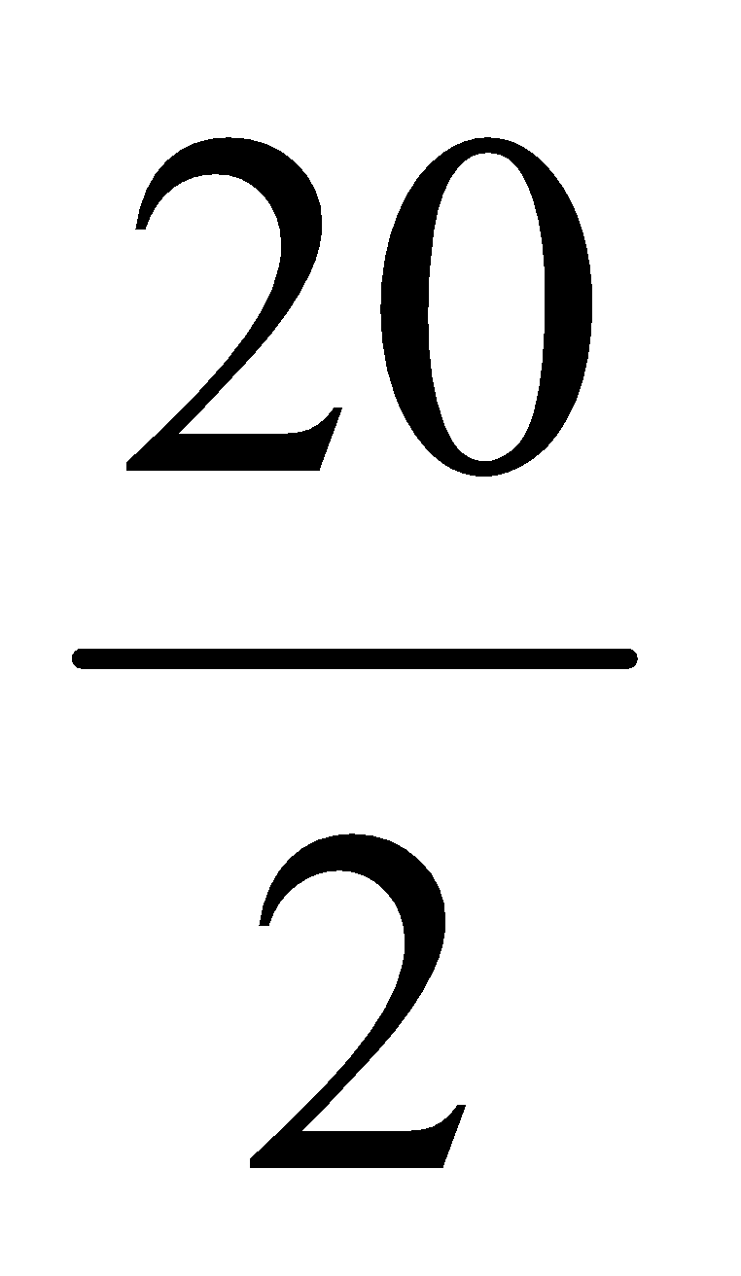
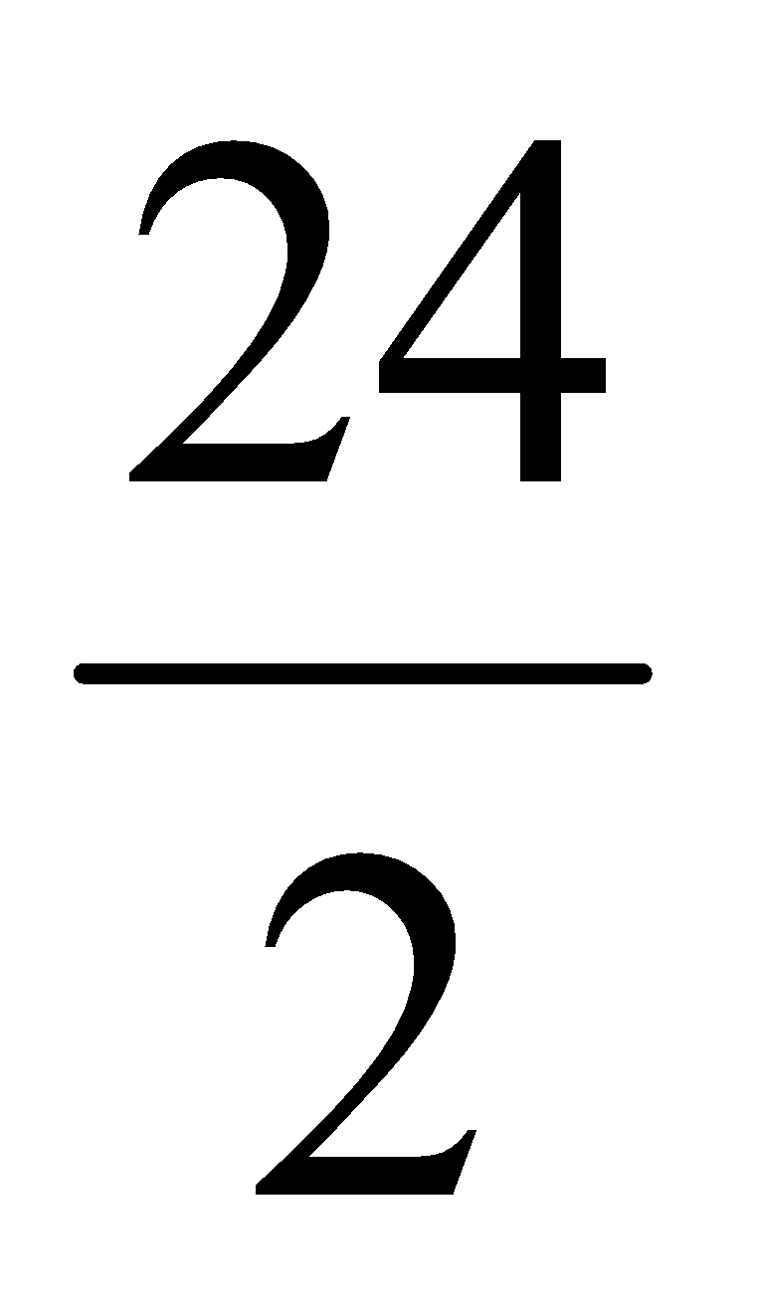
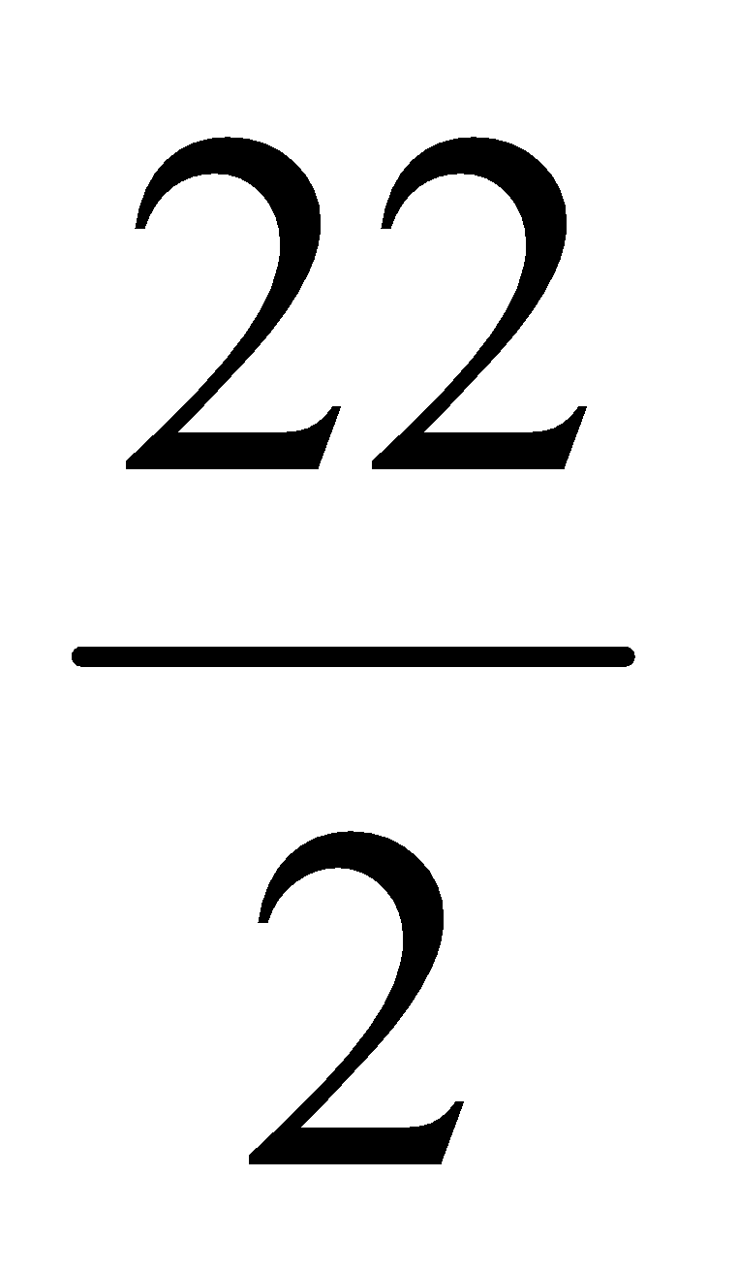
EXAMPLE
Consider n = 14 elements, find index of 38
  First loop: mid = = 6 (search-space is n/2⁰)
    Because a₆ < 38 so left = mid + 1 = 7
    Consider [7, 13] in the second loop
  Second loop: mid = = 10 (search-space is n/2¹)
    Because a₁₀ < 38 so left = mid + 1 = 11
    Consider [11, 13] in the third loop
  Third loop: mid = = 12 (search-space is n/2²)
    Because a₁₂ > 28 so right = mid – 1 = 11
    Consider [11, 11] in the fourth loop
  Fourth loop: mid = = 11 (search-space is n/2³)
    Because a₁₁ = 38 so index is 11 (Finish algorithm)
a₀ | a₁ | a₂ | a₃ | a₄ | a₅ | a₆ | a₇ | a₈ | a₉ | a₁₀ | a₁₁ | a₁₂ | a₁₃
1 | 5 | 8 | 10 | 12 | 15 | 19 | 22 | 26 | 29 | 33 | 38 | 42 | 50

Slide 26
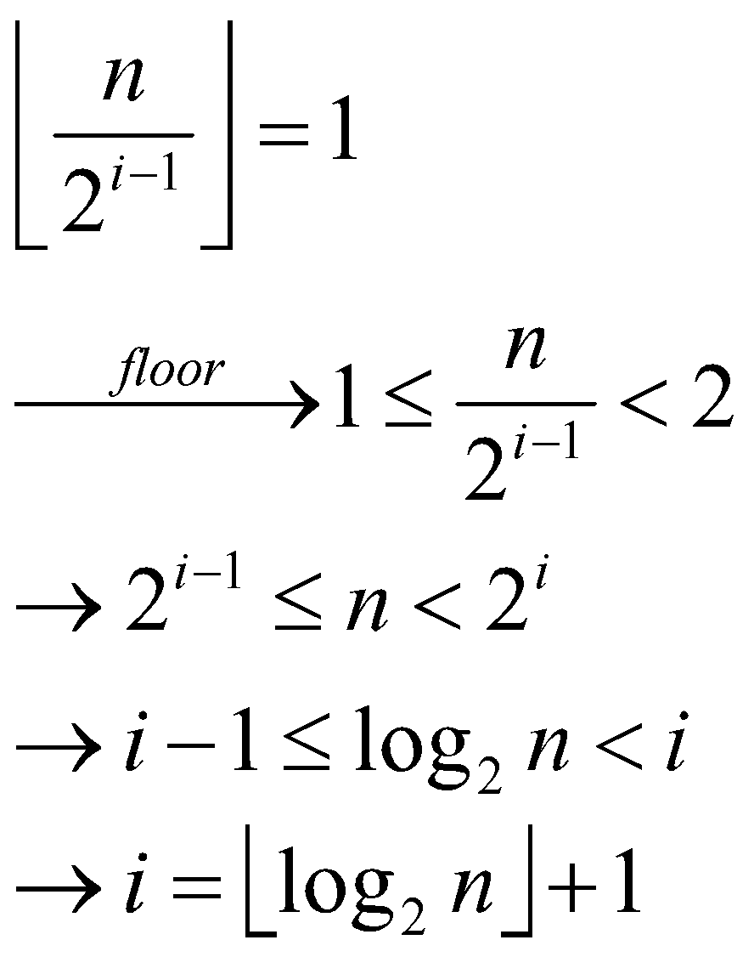
EXAMPLE
Consider below array, find index of 38
Loop until search–space is 1. So we have:
a₀ | a₁ | a₂ | a₃ | a₄ | a₅ | a₆ | a₇ | a₈ | a₉ | a₁₀ | a₁₁ | a₁₂ | a₁₃
1 | 5 | 8 | 10 | 12 | 15 | 19 | 22 | 26 | 29 | 33 | 38 | 42 | 50

Slide 27
SOME BASIC TECHNIQUE
Sentinel technique
  lc ← a₀
  while(i < n) do
    if(<điều kiện lc & a_{i}>) then lc ← a_{i}
    i++;
  end while
  write lc
Flag technique
  kt ← true
  while(i < n) do
    if(<a_{i}>) then kt ← false
    i++;
  end while
  write kt

